Slide 1
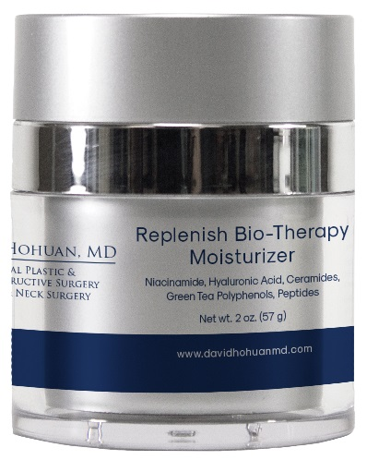
Replenish Bio-Therapy Moisturizer
Feature | Benefit
Biomimetic Ceramide Complex Ceramide NP, Ceramide AP, Ceramide EOP, Ceramide-2 | Mimics the ceramides found naturally in skin to help prevent TEWL. Helps to repair the skin barrier, improving elasticity and texture
Tetrapeptide-21 | Complements the skin’s nightly renewal & metabolic functions, supports the skin matrix to target wrinkles
Hyaluronic Acid Sodium Hyaluronate, Hydrolyzed Sodium Hyaluronate | Penetrates skin to deeply moisturize and forms a protective barrier on skin’s surface, locking moisture in
Niacinamide | Supports healthy collagen production improving the appearance of fine lines and wrinkles Helps fade discoloration over time Promotes healthy texture and even tone
Green Tea Polyphenols, Resveratrol, Caffeine USP, Vitamin E | Calm and soothe skin, while protecting from free radical damage
(847)
Notes:
1

Slide 2
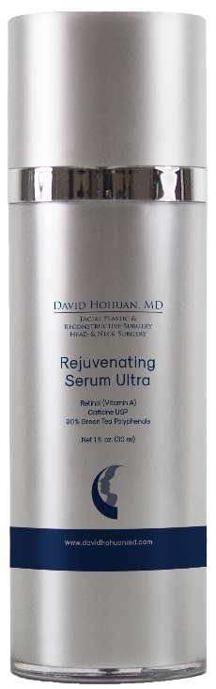
Rejuvenating Serum Plus, Rejuvenating Serum Ultra
2x, 3x, 5x, 10x
Feature | Benefit
All-trans-Retinol, the pure and active form of vitamin A | Assists in the achievement of smoother, firmer and more evenly toned skin and helps support barrier function
Micropolymer Delivery System | Protects the potency of the retinol and provides a time released delivery system
Therapeutic levels of the highest purified and concentrated form of Green Tea | Provide the broadest antioxidant benefits while calming the skin
Special relationship: All-trans-Retinol and Green Tea Polyphenols | Studies show they work synergistically to build up the skin matrix
Caffeine | Enhances overall antioxidant activity, helps diminish the appearance of redness
Hyaluronic Acid | Provides hydration 1,000x its weight
Gluten, Paraben, Oil & Fragrance-free, Non-comedogenic
(875-878)

Slide 3
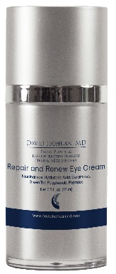
Repair and Renew Eye Cream
Feature | Benefit
All-trans Retinol At the appropriate level for the delicate eye area | Helps increase firmness and elasticity
Hyaluronic Acid Sodium Hyaluronate, Hydrolyzed Sodium Hyaluronate | In various molecular forms, penetrates skin to deeply hydrate and lock in moisture
Niacinamide | A powerful antioxidant with brightening properties to help skin appear more radiant and evenly toned
Green Tea Polyphenols, Vitamins C & E, Emblica | Calms and soothes skin, while quenching free-radicals
Ceramide/Peptide Complex | Nourishes skin while supporting proper lymphatic drainage. Enhances firmness and elasticity to visibly reduce the appearance of fine lines and wrinkles
Vitamin K and Arnica | Help to diminish the appearance of bruising and discoloration
Caffeine USP | Assists in reducing puffiness
Paraben, oil, gluten, fragrance-free. Non-comedogenic | Great for sensitive skin
(848)
Notes:
3

Slide 4
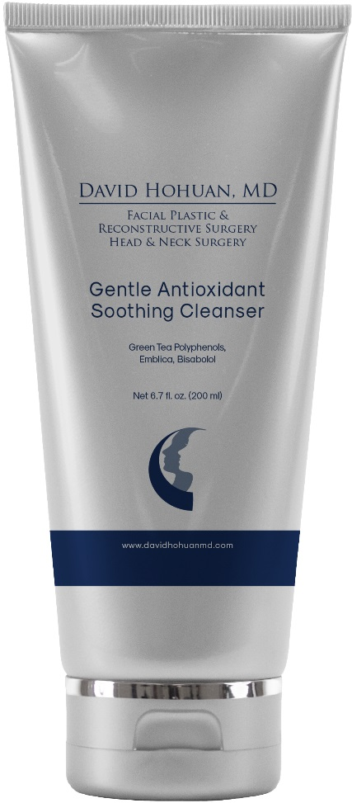
Gentle Antioxidant Soothing Cleanser
Benefit
Gently cleanses & nourishes the skin
Contains Green Tea Polyphenols, Emblica, Bisabolol, Cucumber Ext, Ectoin, Panthenol, Yucca Ext, Vitamin C
Removes environmental pollutants & excess oil
Provides hydration
Prepares the skin for topical treatment
Ultra calming and soothing solution
Suitable for all skin types – including sensitive
pH Balanced
Gluten, Paraben, Soap and Alcohol-free Hypo-allergenic fragrance, Non-comedogenic
(839)
Notes:
4

Slide 5
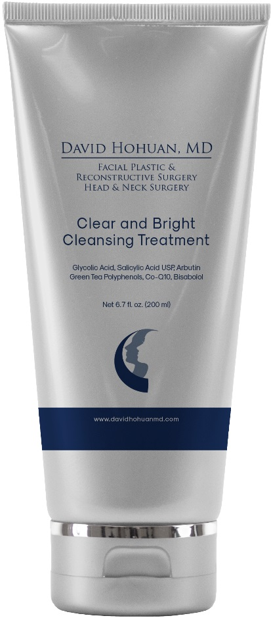
Clear and Bright Cleansing Treatment
Benefit
Gentle facial exfoliator with bio-friendly exfoliation beads
Contains Glycolic acid, Salicylic acid, Arbutin, Vitamin C, Green Tea Polyphenols, Co-Q10
Mild, brightening, creamy polish
Helps to regulate oil, purify & minimize pores
Enhances skin tone & texture & reveals fresh complexion
Suitable for all skin types and for daily use
Gluten, Paraben, Oil and Sulfate-free Hypoallergenic fragrance, Non-comedogenic
(849)
Notes:
5

Slide 6
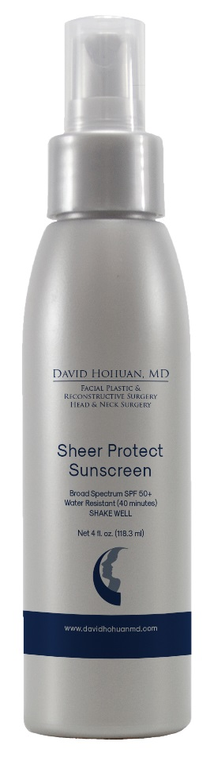
Sheer Protect Spray Sunscreen
Broad Spectrum SPF50+
Feature | Benefit
Pure Physical only, Micronized Zinc Oxide | Provides superior broad-spectrum UVA/UVB protection
Advanced technology | Delivers high levels of evenly distributed sheer zinc oxide
Antioxidant coverage: Green Tea Polyphenols, Resveratrol, Emblica, Vitamin C & E & Co-Q10 | Calm the skin, neutralize and quench UV induced free-radicals
Ascorbic acid (Vitamin C) | A powerful antioxidant with brightening properties to help skin appear more radiant and evenly toned
Weightless, residue-free, transparent finish formula | Great for all skin types, including sensitive and acne
Gluten, Oil, Alcohol, Fragrance, Paraben, & Chemical-free Non-comedogenic & non-whitening
(857, 858)
Notes:
6

Slide 7
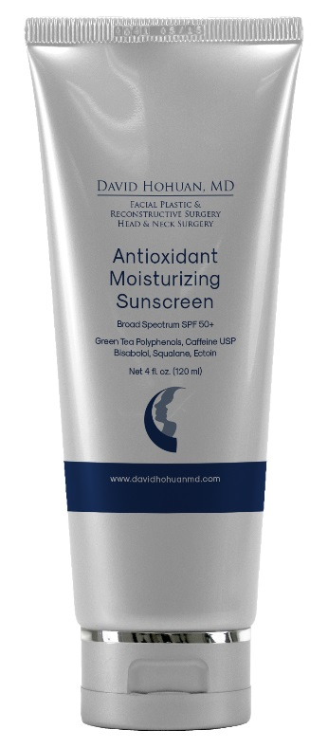
Antioxidant Moisturizing Sunscreen
Broad Spectrum SPF50+
Feature | Benefit
Formulated with Micronized Zinc Oxide 6%, Homosalate 7%, Octinoxate 7.5%, Oxybenzone 5%, Octisalate 5% | Provides the highest broad spectrum UVA & UVB protection that is sensitive skin friendly
Tinted from concentrated levels of Green Tea Polyphenols | Provides the broadest antioxidant benefits while calming the skin
Antioxidant enriched formula: Caffeine, Activated Vitamin E, Silymarin, Bisabolol, and Ectoin | Help calm, moisturize and guard skin against free-radicals
Moisturizing ingredients Squalane & Hyaluronic Acid | For intense hydration
Gluten, Paraben, Oil, Alcohol and Fragrance-free | Excellent as a makeup primer
(879)

Slide 8
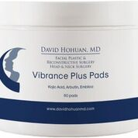
Skin Tone Enhancement Therapy
Vibrance Plus Pads
Feature | Benefit
2% Kojic acid, Arbutin & Bearberry | Brighten and even skin tone
Antioxidants: Silymarin, Ascorbic acid, Emblica, Curcumoids & Green Tea Polyphenols | Calm & soothe the skin & guard against free radicals
Trans-dermal penetration system | Advanced penetrating vehicle
Cosmetic formulation, non-drug, non-systemic
Hydroquinone-Free Gluten, Alcohol, Acetone, Paraben and Fragrance-free | Designed for all skin types
60 pads | Convenient application
(150)

Slide 9
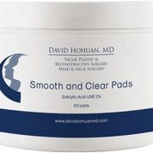
Smooth and Clear Pads
2-2, 5-2, 10-2
Feature | Benefit
Formulated with the purest pharmaceutical grade Glycolic Acid available | Ensures minimal irritation and accelerates the removal of dead skin cells that can interfere with the proper oil drainage of the skin
Combined with acne fighting ingredient Salicylic Acid USP 2%. | Pharmaceutical active acne medication ingredient removes surface oils, unplugs and refines pores
Witch Hazel - a proven astringent | Helps reduce surface oil and refine pore size
Excellent and affordable solution for pediatric and adolescent patients | Easy-to-use cleansing/toning pads
Gluten, Paraben, Oil, Sulfate, Colorant and Fragrance-free Non-comedogenic
(923, 711, 712)
Notes:
9

